Slide 1





Noida Institute of Engineering and Technology, Greater Noida
Tree and Graph
Unit: 5
Discrete Structure
ANAMIKA TIWARI
Assistant Professor
B.Tech AIML
B. Tech 3rd Sem

Slide 2
Introduction
Noida Institute of Engineering and Technology, Greater Noida
ANAMIKA TIWARI
B.Tech and M.Tech in CSE with 4 Years Teaching Experience
Area of Expertise: Image Processing and Software Engineering
Attended and Conducted Numerous Workshops.
Published about 5 National and International Papers in reputed Journals.
Attend various FDPs and Webinar.
ANAMIKA TIWARI Discrete Structures Unit 5

Slide 3
NOIDA INSTITUTE OF ENGINEERING & TECHNOLOGY, GREATER NOIDA(An Autonomous Institute) EVALUATION SCHEME SEMESTER-III
Sl. No. | Subject Codes | Subject Name |  | Periods |  |  | Evaluation Schemes |  |  |  | End Semester |  | Total | Credit
 |  |  |  | L | T | P | CT | TA | TOTAL | PS | TE | PE
WEEKS COMPULSORY INDUCTION PROGRAM
1 | AAS0303 |  | Statistics and Probability | 3 | 1 | 0 | 30 | 20 | 50 |  | 100 |  | 150 | 4
2 | ACSE0306 |  | Discrete Structures | 3 | 0 | 0 | 30 | 20 | 50 |  | 100 |  | 150 | 3
3 | ACSE0305 |  | Computer Organization & Architecture | 3 | 0 | 0 | 30 | 20 | 50 |  | 100 |  | 150 | 3
4 | ACSE0302 |  | Object Oriented Techniques using Java | 3 | 0 | 0 | 30 | 20 | 50 |  | 100 |  | 150 | 3
5 | ACSE0301 |  | Data Structures | 3 | 1 | 0 | 30 | 20 | 50 |  | 100 |  | 150 | 4
6 | ACSDS0301 |  | Foundations of Data Science | 3 | 0 | 0 | 30 | 20 | 50 |  | 100 |  | 150 | 3
7 | ACSE0352 |  | Object Oriented Techniques using Java Lab | 0 | 0 | 2 |  |  |  | 25 |  | 25 | 50 | 1
8 | ACSE0351 |  | Data Structures Lab | 0 | 0 | 2 |  |  |  | 25 |  | 25 | 50 | 1
9 | ACSDS0351 |  | Data Analysis Lab | 0 | 0 | 2 |  |  |  | 25 |  | 25 | 50 | 1
10 | ACSE0359 |  | Internship Assessment-I | 0 | 0 | 2 |  |  |  | 50 |  |  | 50 | 1
11 | ANC0301 / ANC0302 |  | Cyber Security* / Environmental Science*(Non Credit) | 2 | 0 | 0 | 30 | 20 | 50 |  | 50 |  | 100 | 0
12 |  |  | MOOCs (For B.Tech. Hons. Degree)
 |  |  | GRAND TOTAL |  |  |  |  |  |  |  |  |  | 1100 | 24

Slide 4
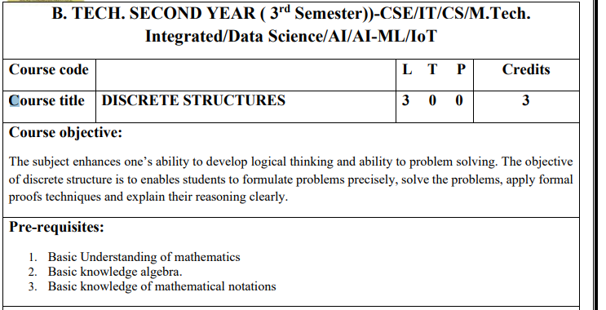
Subject Syllabus
ANAMIKA TIWARI Discrete Structures Unit 5

Slide 5
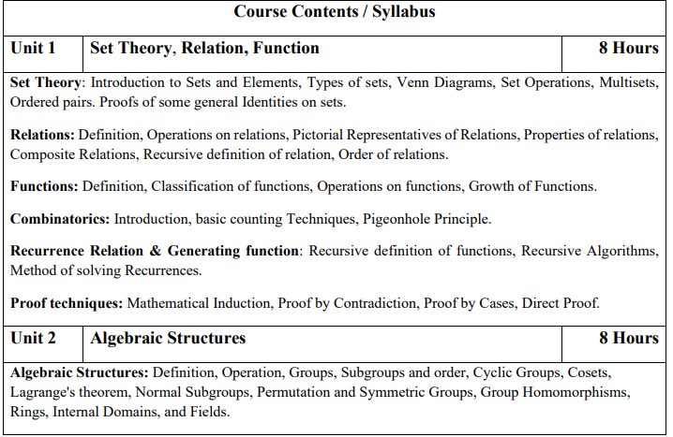
Subject Syllabus
ANAMIKA TIWARI Discrete Structures Unit 5

Slide 6
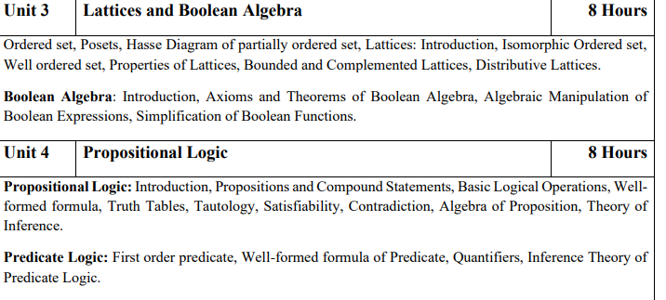
Subject Syllabus
ANAMIKA TIWARI Discrete Structures Unit 5

Slide 7
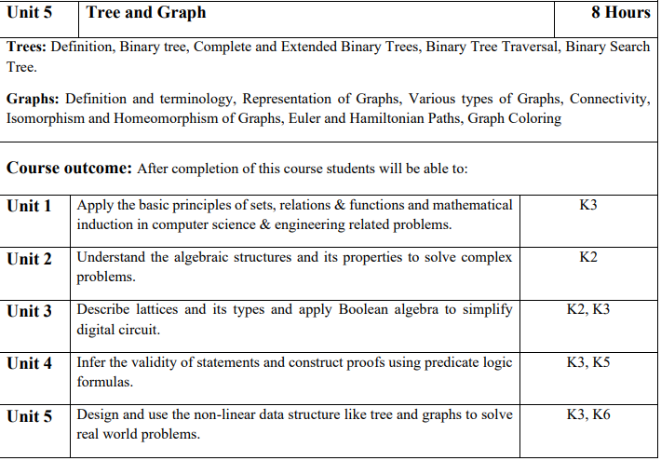
Subject Syllabus
ANAMIKA TIWARI Discrete Structures Unit 5

Slide 8
Application in CSE
1. Discrete Structures are useful in studying and describing objects and problems in branches of computer science such as computer algorithms, programming languages.
2. Computer implementations are significant in applying ideas from discrete mathematics to real-world problems, such as in operations research.
3. It is a very good tool for improving reasoning and problem-solving capabilities.
4. Discrete mathematics is used to include theoretical computer science, which is relevant to computing.
5. Discrete structures in computer science with the help of process algebras.
ANAMIKA TIWARI Discrete Structures Unit 5

Slide 9
Course Objective
The subject enhances one’s ability to develop logical thinking and ability to problem solving.
The objective of discrete structure is to enables students to formulate problems precisely, solve the problems, apply formal proofs techniques and explain their reasoning clearly.
ANAMIKA TIWARI Discrete Structures Unit 5

Slide 10
Course Outcome
Course Outcome (CO) | At the end of course , the student will be able to | Bloom’s Knowledge Level (KL)
CO1 | Apply the basic principles of sets, relations & functions and mathematical induction in computer science & engineering related problems | K3
CO2 | Understand the algebraic structures and its properties to solve complex problems | K2
CO3 | Describe lattices and its types and apply Boolean algebra to simplify digital circuit. | K2,K3
CO4 | Infer the validity of statements and construct proofs using predicate logic formulas. | K3,K5
CO5 | Design and use the non-linear data structure like tree and graphs to solve real world problems. | K3,K6
ANAMIKA TIWARI Discrete Structures Unit 5

Slide 11
Content
Course Objective
Course Outcome
CO-PO Mapping
Syllabus
Prerequisite and Recap
Graph and digraph
Incidence and adjacency matrix
Isomorphism
Eulerian path and circuits in graphs
Hamiltonian path and circuits
Trees
Four color theorem
ANAMIKA TIWARI Discrete Structures Unit 5

Slide 12
Content
Planar graphs
Clique number
Chromatic number
Video links
Daily Quiz
Weekly Assignment
MCQ
Old Question papers
Expected Question for University Exam
Summary
References.
ANAMIKA TIWARI Discrete Structures Unit 5

Slide 13
Course Objective
The subject enhances one’s ability to develop logical thinking and ability to problem solving.
Demonstrate the ability to write and evaluate a proof or outline the basic structure of and give examples of each proof technique described.
Apply logical reasoning to solve a variety of problems.
Use Mathematically correct terminology and notation.
ANAMIKA TIWARI Discrete Structures Unit 5

Slide 14
Course Outcome
Course Outcome (CO) | At the end of course , the student will be able to | Bloom’s Knowledge Level (KL)
CO1 | Apply the basic principles of sets, relations & functions and mathematical induction in computer science & engineering related problems | K3
CO2 | Understand the algebraic structures and its properties to solve complex problems | K2
CO3 | Describe lattices and its types and apply Boolean algebra to simplify digital circuit. | K2,K3
CO4 | Infer the validity of statements and construct proofs using predicate logic formulas. | K3,K5
CO5 | Design and use the non-linear data structure like tree and graphs to solve real world problems. | K3,K6
ANAMIKA TIWARI Discrete Structures Unit 5

Slide 15
Program Outcomes
Program Outcome
Engineering Graduates will be able to Understand:
1. Engineering knowledge
2. Problem analysis
3. Design/development of solutions
4. Conduct investigations of complex
5. Modern tool usage
6. The engineer and society
7. Environment and sustainability
8. Ethics
9. Individual and team work
10. Communication
11. Project management and finance
12. Life-long learning
ANAMIKA TIWARI Discrete Structures Unit 5

Slide 16
CO-PO Mapping
CO-PO correlation matrix Discrete Structures (ACSE0306)
 | PO1 | PO2 | PO3 | PO4 | PO5 | PO6 | PO7 | PO8 | PO9 | PO10 | PO11 | PO12
ACSE0306.1 | 2 | 2 | 3 | 3 | 2 | 2 | - | - | 2 | 1 | - | 3
ACSE0306.2 | 1 | 3 | 2 | 3 | 2 | 2 | - | 1 | 1 | 1 | 2 | 2
ACSE0306.3 | 2 | 2 | 3 | 2 | 2 | 2 | - | 2 | 2 | 1 | 2 | 3
ACSE0306.4 | 2 | 2 | 2 | 3 | 2 | 2 | - | 2 | 2 | 1 | 1 | 3
ACSE306.5 | 3 | 2 | 2 | 2 | 2 | 2 | - | 2 | 1 | 1 | 1 | 2
Average | 2 | 2.2 | 2.4 | 2.6 | 2 | 2 | - | 1.4 | 1.6 | 1 | 1.2 | 2.6
ANAMIKA TIWARI Discrete Structures Unit 5

Slide 17

End Semester Question Paper Templates (Offline Pattern/Online Pattern
ANAMIKA TIWARI Discrete Structures Unit 5

Slide 18
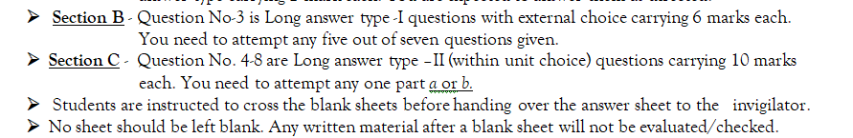
End Semester Question Paper Templates (Offline Pattern/Online Pattern
ANAMIKA TIWARI Discrete Structures Unit 5

Slide 19
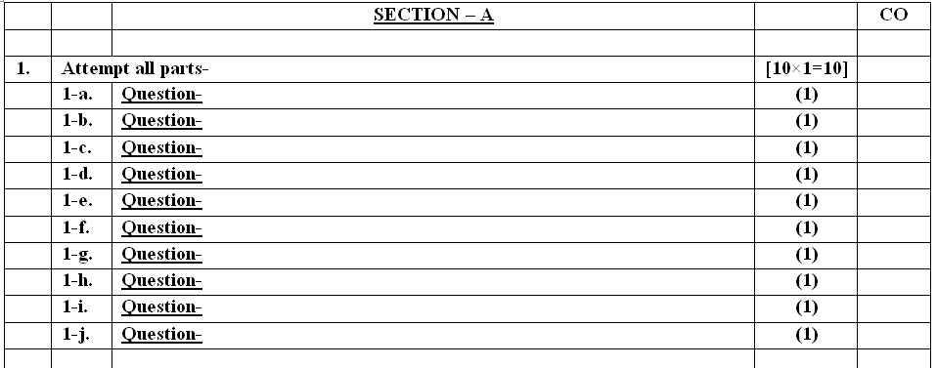
End Semester Question Paper Templates (Offline Pattern/Online Pattern
ANAMIKA TIWARI Discrete Structures Unit 5

Slide 20
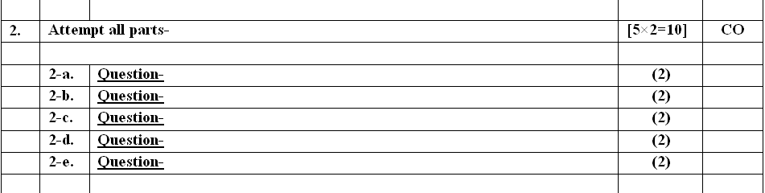
End Semester Question Paper Templates (Offline Pattern/Online Pattern
ANAMIKA TIWARI Discrete Structures Unit 5

Slide 21
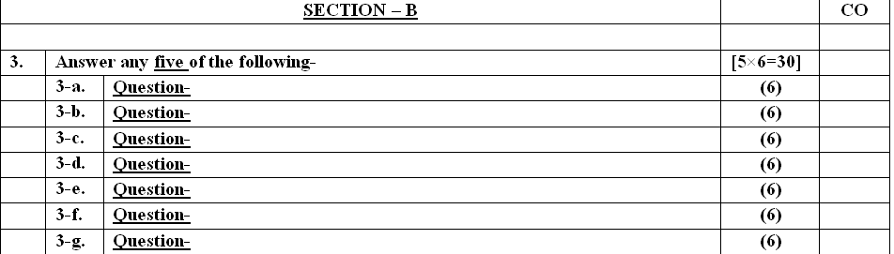
End Semester Question Paper Templates (Offline Pattern/Online Pattern
ANAMIKA TIWARI Discrete Structures Unit 5

Slide 22
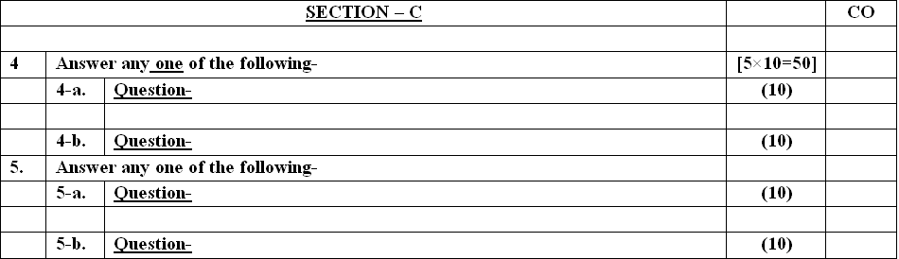
End Semester Question Paper Templates (Offline Pattern/Online Pattern
ANAMIKA TIWARI Discrete Structures Unit 5

Slide 23
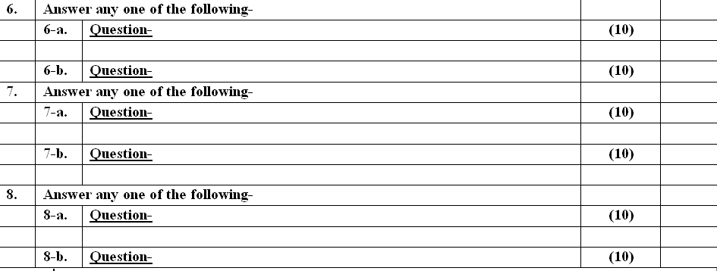
End Semester Question Paper Templates (Offline Pattern/Online Pattern
ANAMIKA TIWARI Discrete Structures Unit 5

Slide 24
Prerequisite & Recap
Prerequisite
Knowledge of Mathematics upto 12th standard.
Recap
The fundamental concepts of Sets, Relations and Functions, Logic, Probability and Boolean Algebra.
ANAMIKA TIWARI Discrete Structures Unit 5

Slide 25
Brief Introduction about the subject with video
Discrete mathematics is the study of mathematical structures that are fundamentally discrete rather than continuous. In contrast to real numbers that have the property of varying "smoothly", the objects studied in discrete mathematics – such as integers, Trees, graphs, and statements in logic.
https://www.youtube.com/watch?v=Dsi7x-A89Mw&list=PL0862D1A94725 2D20&index=28
https://www.youtube.com/watch?v=74l6t4_4pDg&list=PL0862D1A947252D20&index=29
https://www.youtube.com/watch?v=4d2XEn1j_q4&list=PL0862D1A947252D20&index=30
ANAMIKA TIWARI Discrete Structures Unit 5

Slide 26
Unit Content
Tree
Binary Tree
Tree Traversal
Binary Search Tree
Graphs
Types of Graph
Graph coloring
ANAMIKA TIWARI Discrete Structures Unit 5

Slide 27
Unit Objective: Tree and Graph (CO5)
Define how Tree and graphs will be serve as models for many standard problems.
How Graph theory will be used in Computer networks to minimize the cost and time of delivery of data.
To distinguish between two chemical compounds with the same molecular formula but different structures.
To solve shortest path problems between cities.
To schedule exams and assign channels to television stations.
ANAMIKA TIWARI Discrete Structures Unit 5

Slide 28
Trees (CO5)
A tree is a connected graph containing no cycles.
A graph T is a tree if and only if between every pair of distinct vertices of T there is a unique path.
Let T be a tree with v vertices and e edges. Then e=v−1.
Example:
G=(V,E) with V={a,b,c,d,e} and E={{a,b},{b,c},{c,d},{d,e}} is a tree.
ANAMIKA TIWARI Discrete Structures Unit 5

Slide 29
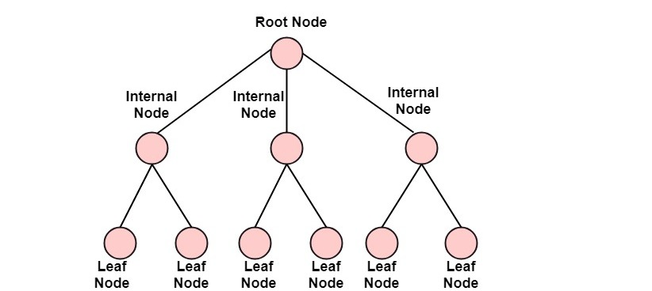
Trees terminology (CO5)
ANAMIKA TIWARI Discrete Structures Unit 5

Slide 30
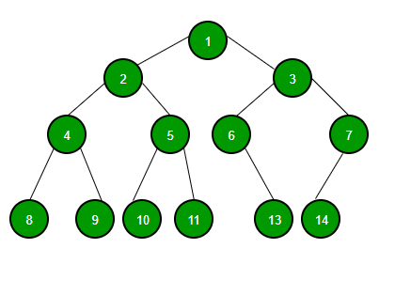
Binary Trees (CO5)
A tree whose elements have at most 2 children is called a binary tree. Since each element in a binary tree can have only 2 children, we typically name them the left and right child.
A Binary Tree node contains following parts.
Data
Pointer to left child
Pointer to right child
ANAMIKA TIWARI Discrete Structures Unit 5

Slide 31

Binary Trees (CO5)
Binary Tree(Properties)
1) The maximum number of nodes at level ‘l’ of a binary tree is 2^{l}.
Here level is the number of nodes on the path from the root to the node (including root and node). Level of the root is 0.
This can be proved by induction.
For root, l = 0, number of nodes = 2⁰ = 1
Assume that the maximum number of nodes on level ‘l’ is 2^{l}
Since in Binary tree every node has at most 2 children, next level would have twice nodes, i.e. 2 * 2^{l}
2. The Maximum number of nodes in a binary tree of height ‘h’ is 2^{h+1} – 1.
3. In a Binary Tree with N nodes, minimum possible height or the minimum number of levels is? log₂(N+1) -1
ANAMIKA TIWARI Discrete Structures Unit 5

Slide 32
Binary Tree (CO5)
Types of Binary Tree
Complete Binary Tree
Full Binary Tree
Balanced Binary Tree
A degenerate (or pathological) tree
ANAMIKA TIWARI Discrete Structures Unit 5

Slide 33
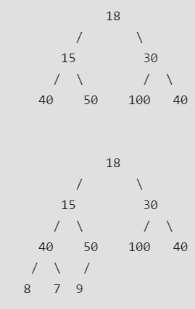
Trees (CO5)
Complete Binary Tree: A Binary Tree is a complete Binary Tree if all the levels are completely filled except possibly the last level and the last level has all keys as left as possible
The following are examples of Complete Binary Trees
ANAMIKA TIWARI Discrete Structures Unit 5

Slide 34
There are three ways which we use to traverse a tree
Binary Trees Traversal (CO5)
In-order Traversal
Pre-order Traversal
Post-order Traversal
ANAMIKA TIWARI Discrete Structures Unit 5

Slide 35
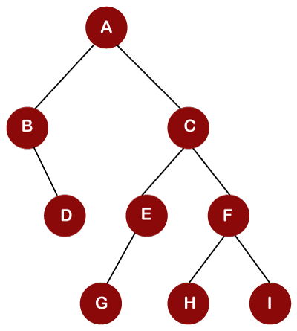
Inorder traversal (CO5)
Inorder traversal : Left Root Right.
B, D, A, G, E, C, H, F, I.
ANAMIKA TIWARI Discrete Structures Unit 5

Slide 36
Preorder traversal (CO5)
Preorder traversal : Root Left Right.
A, B, D, C, E, G, F, H, I
ANAMIKA TIWARI Discrete Structures Unit 5

Slide 37
Postorder traversal (CO5)
Postorder traversal : Left Right Root
D, B, G, E, H, I, F, C, A.
ANAMIKA TIWARI Discrete Structures Unit 5

Slide 38
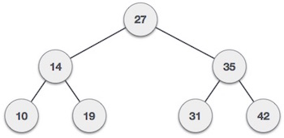
Binary Search Tree (CO5)
Binary Search tree exhibits a special behavior.
A node's left child must have a value less than its parent's value and the node's right child must have a value greater than its parent value.
ANAMIKA TIWARI Discrete Structures Unit 5

Slide 39
BST Basic Operations
Binary Search Trees (C05)
The basic operations that can be performed on a binary search tree data structure, are the following −
Insert − Inserts an element in a tree/create a tree.
Search − Searches an element in a tree.
Preorder Traversal − Traverses a tree in a pre-order manner.
Inorder Traversal − Traverses a tree in an in-order manner.
Postorder Traversal − Traverses a tree in a post-order manner.
We shall learn creating (inserting into) a tree structure and searching a data item in a tree in this chapter. We shall learn about tree traversing methods in the coming chapter.
ANAMIKA TIWARI Discrete Structures Unit 5

Slide 40
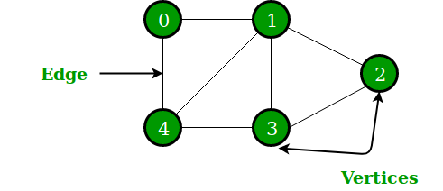
Definition of a Graph( CO 5)
A generalization of the simple concept of a set of dots, links, edges or arcs.
Representation:
Graph G =(V, E) consists set of vertices denoted by V, or by V(G) and set of edges E, or E(G)
In the above Graph, the set of vertices V = {0,1,2,3,4} and the set of edges E = {01, 12, 23, 34, 04, 14, 13}.
ANAMIKA TIWARI Discrete Structures Unit 5

Slide 41
Definitions – Edge Type( CO 5)
Directed: Ordered pair of vertices. Represented as (u, v) directed from vertex u to v.
Undirected: Unordered pair of vertices. Represented as {u, v}. Disregards any sense of direction and treats both end vertices interchangeably
u
v
u
v
ANAMIKA TIWARI Discrete Structures Unit 5

Slide 42
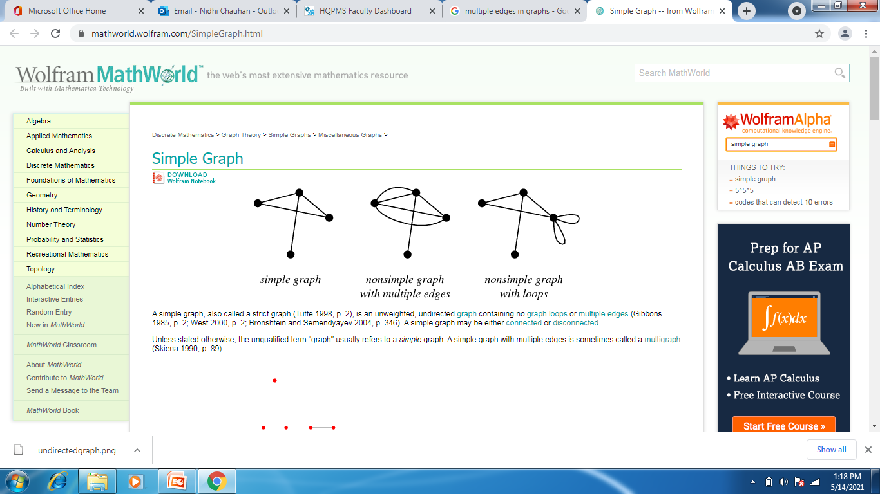
Definitions – Edge Type( CO 5)
Loop: A loop is an edge whose endpoints are equal i.e., an edge joining a vertex to it self is called a loop. Represented as {u, u} = {u}
Multiple Edges: Two or more edges joining the same pair of vertices
u
ANAMIKA TIWARI Discrete Structures Unit 5

Slide 43
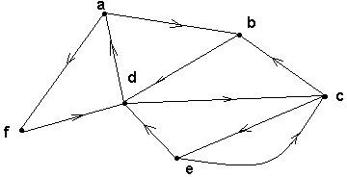
Directed graphs(Digraph) (CO 5)
G is a directed graph or digraph if each edge has been associated with an ordered pair of vertices, i.e. each edge has a direction
ANAMIKA TIWARI Discrete Structures Unit 5

Slide 44
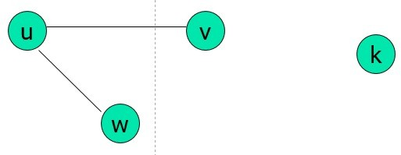
Terminology – Undirected graphs(CO5)
u and v are adjacent if {u, v} is an edge, e is called incident with u and v. u and v are called endpoints of {u, v}
Degree of Vertex (deg (v)): the number of edges incident on a vertex. A loop contributes twice to the degree (why?).
Pendant Vertex: deg (v) =1
Isolated Vertex: deg (v) = 0
Representation Example: For V = {u, v, w} , E = { {u, w}, {u, w}, (u,v) }, deg (u) = 2, deg (v) = 1, deg (w) = 1, deg (k) = 0, w and v are pendant , k is isolated
ANAMIKA TIWARI Discrete Structures Unit 5

Slide 45
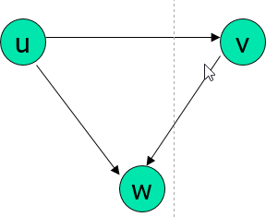
Terminology – Undirected graphs(CO5)
For the edge (u, v), u is adjacent to v OR v is adjacent from u, u – Initial vertex, v – Terminal vertex
In-degree (deg⁻ (u)): number of edges for which u is terminal vertex
Out-degree (deg⁺ (u)): number of edges for which u is initial vertex
Note: A loop contributes 1 to both in-degree and out-degree (why?)
Representation Example: For V = {u, v, w} , E = { (u, w), ( v, w), (u, v) }, deg⁻ (u) = 0, deg⁺ (u) = 2, deg⁻ (v) = 1,
deg⁺ (v) = 1, and deg⁻ (w) = 2, deg⁺ (u) = 0
ANAMIKA TIWARI Discrete Structures Unit 5

Slide 46
Handshaking Theorem (CO4)
Handshaking Theorem
Handshaking theorem states that the sum of degrees of the vertices of a graph is twice the number of edges. If G=(V,E) be a graph with E edges, then-
Σ deg G(V) = 2E
Proof-
Since the degree of a vertex is the number of edges incident with that vertex, the sum of degree counts the total number of times an edge is incident with a vertex. Since every edge is incident with exactly two vertices, each edge gets counted twice once at each end. Thus the sum of the degrees is equal twice the number of edges.
This theorem applies even if multiple edges and loops are present. The theorem holds this rule that if several people shake hands, the total number of hands shake must be even that is why the theorem is called handshaking theorem.
ANAMIKA TIWARI Discrete Structures Unit 5

Slide 47
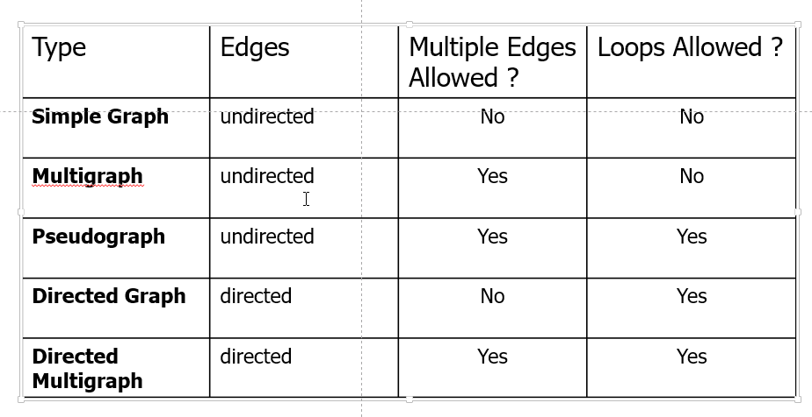
Summary of Graph Types(CO5)
ANAMIKA TIWARI Discrete Structures Unit 5

Slide 48
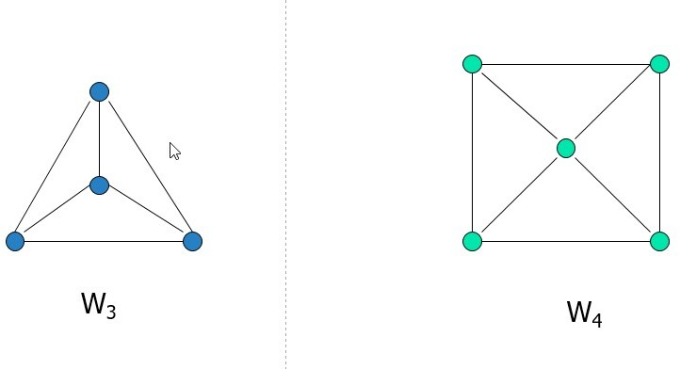
Simple graph – special case(CO 5)
Wheels: W_{n}, obtained by adding additional vertex to Cn and connecting all vertices to this new vertex by new edges.
Representation Example: W₃, W₄
ANAMIKA TIWARI Discrete Structures Unit 5

Slide 49
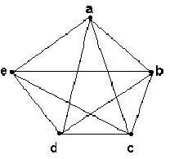
Complete graph K _{n}(CO 5)
Let n > 3
The complete graph K_{n} is the graph with n vertices and every pair of vertices is joined by an edge.
The figure represents K₅
ANAMIKA TIWARI Discrete Structures Unit 5

Slide 50
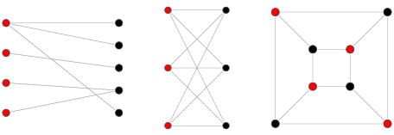
Bipartite graphs(CO 5)
A bipartite graph, also called a bi-graph, is a set of graph vertices decomposed into two disjoint sets such that no two graph vertices within the same set are adjacent. A bipartite graph is a special case of a k-partite graph with k=2 .
The illustration above shows some bipartite graphs, with vertices in each graph colored based on to which of the two disjoint sets they belong.
Bipartite graphs are equivalent to two-colorable graphs. All acyclic graphs are bipartite. A cyclic graph is bipartite iff all its cycles are of even length
ANAMIKA TIWARI Discrete Structures Unit 5

Slide 51
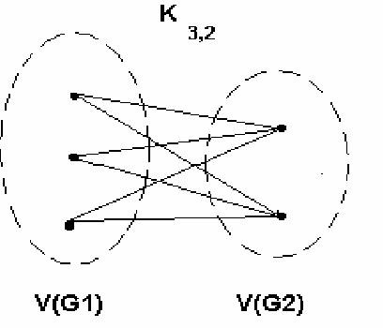
Complete bipartite graph K_{m,n}(CO 5)
A bipartite graph is the
complete bipartite graph K_{m,n} if
every vertex in V(G₁) is joined to a vertex in V(G₂) and
conversely,
|V(G₁)| = m
|V(G₂)| = n
ANAMIKA TIWARI Discrete Structures Unit 5

Slide 52
Representation of Graphs(CO5)
Incidence (Matrix): Most useful when information about edges is
more desirable than information about vertices.
Adjacency (Matrix/List): Most useful when information about the vertices is more desirable than information about the edges. These two representations are also most popular since information about the vertices is often more desirable than edges in most applications.
ANAMIKA TIWARI Discrete Structures Unit 5

Slide 53
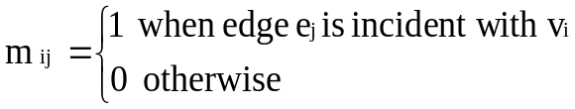
Representation- Incidence Matrix(CO5)
G = (V, E) be an unditected graph. Suppose that v₁, v₂, v₃, …, v_{n} are the vertices and e₁, e₂, …, e_{m} are the edges of G. Then the incidence matrix with respect to this ordering of V and E is the n x m matrix M = [m _{ij}], where
Can also be used to represent :
Multiple edges: by using columns with identical entries, since these edges are incident with the same pair of vertices
Loops: by using a column with exactly one entry equal to 1, corresponding to the vertex that is incident with the loop
ANAMIKA TIWARI Discrete Structures Unit 5

Slide 54
Representation-Incidence matrix(CO5)
Representation Example: G = (V, E)
u
 | e₁ | e₂ | e₃
v | 1 | 0 | 1
u | 1 | 1 | 0
w | 0 | 1 | 1
e1
e2
v
w
e3
ANAMIKA TIWARI Discrete Structures Unit 5

Slide 55
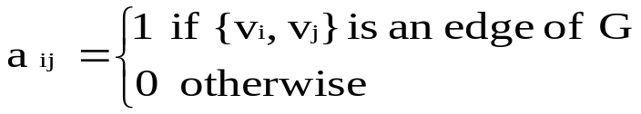

Representation- Adjacency Matrix(CO5)
There is an N x N matrix, where |V| = N , the Adjacenct Matrix (NxN) A = [a_{ij}]
For undirected graph
For directed graph
This makes it easier to find sub-graphs, and to reverse graphs if needed.
ANAMIKA TIWARI Discrete Structures Unit 5

Slide 56
Representation-Adjacency matrix(CO5)
Representation of undirected graph G = (V, E)
u
 | v | u | w
v | 0 | 1 | 1
u | 1 | 0 | 1
w | 1 | 1 | 0
v
w
ANAMIKA TIWARI Discrete Structures Unit 5

Slide 57
Representation-Adjacency matrix(CO5)
Representation of directed graph G = (V, E)
 | v | u | w
v | 0 | 1 | 0
u | 0 | 0 | 1
w | 1 | 0 | 0
u
v
w
ANAMIKA TIWARI Discrete Structures Unit 5

Slide 58
Representation-Adjacency list (CO5)
Each node (vertex) has a list of which nodes (vertex) it is adjacent
Representation of undirected graph G = (V, E)
node | Adjacency List
u | v , w
v | w, u
w | u , v
u
v
w
ANAMIKA TIWARI Discrete Structures Unit 5

Slide 59
Graph - Isomorphism(CO5)
G1 = (V1, E2) and G2 = (V2, E2) are isomorphic if:
There is a one-to-one and onto function f from V1 to V2 with the property that
--a and b are adjacent in G1 if and only if f (a) and f (b) are adjacent in G2, for all a and b in V1.
Function f is called isomorphism.
Application Example: In chemistry, to find if two compounds have the same structure
ANAMIKA TIWARI Discrete Structures Unit 5

Slide 60
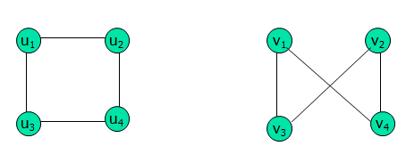
Graph - Isomorphism(CO5)
Representation example: G1 = (V1, E1) , G2 = (V2, E2)
f(u₁) = v₁, f(u₂) = v₄, f(u₃) = v₃, f(u₄) = v₂,
ANAMIKA TIWARI Discrete Structures Unit 5

Slide 61
Graph - Homomorphism(CO5)
A homomorphism from a graph G to a graph H is a mapping (May not be a bijective mapping) h: G → H such that − (x, y) ∈ E(G) → (h(x), h(y)) ∈ E(H). It maps adjacent vertices of graph G to the adjacent vertices of the graph H.
Properties of Homomorphisms
A homomorphism is an isomorphism if it is a bijective mapping.
Homomorphism always preserves edges and connectedness of a graph.
The compositions of homomorphisms are also homomorphisms.
To find out if there exists any homomorphic graph of another graph is a NPcomplete problem.
ANAMIKA TIWARI Discrete Structures Unit 5

Slide 62
Connectivity in Graph (CO5)
Basic idea of connectivity: In a Graph reachability among vertices can be acheived by traversing the edges
Application Example:
- In a city to city road-network, if one city can be reached from another city.
- Problems if determining whether a message can be sent between two
computer using intermediate links
- Efficiently planning routes for data delivery in the Internet
ANAMIKA TIWARI Discrete Structures Unit 5

Slide 63
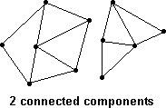
Connectivity in Graph (CO4)
A graph is connected if every pair of vertices can be connected by a path.
A connected graph is an undirected graph in which every unordered pair of vertices in the graph is connected. Otherwise, it is called a disconnected graph.
Each connected subgraph of a non- connected graph G is called a component of G.
ANAMIKA TIWARI Discrete Structures Unit 5

Slide 64
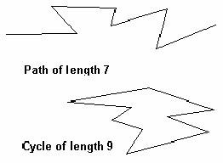
Paths and cycles in Graph (CO 5)
A path of length n is a sequence of n + 1 vertices and n consecutive edges.
A cycle is a path that begins and ends at the same vertex.
ANAMIKA TIWARI Discrete Structures Unit 5

Slide 65

Connectivity- Undirected Graph(CO5)
Undirected Graph
An undirected graph is connected if there exists is a simple path between every pair of vertices.
Representation Example: G (V, E) is connected since for V = {v₁, v₂, v₃, v₄, v₅}, there exists a path between {v_{i}, v_{j}}, 1 ≤ i, j≤ 5
ANAMIKA TIWARI Discrete Structures Unit 5

Slide 66
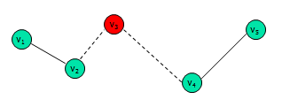
Connectivity- Undirected Graph(CO4)
Undirected Graph
Articulation Point (Cut vertex): removal of a vertex produces a subgraph with more connected components than in the original graph. The removal of a cut vertex from a connected graph produces a graph that is not connected
Cut Edge: An edge whose removal produces a subgraph with more connected components than in the original graph.
Representation example: G (V, E), v₃ is the articulation point or edge {v₂, v₃}, the number of connected components is 2 (> 1)
ANAMIKA TIWARI Discrete Structures Unit 5

Slide 67
Connectivity- Directed Graph(CO5)
Directed Graph
A directed graph is strongly connected if there is a path from a to b and from b to a whenever a and b are vertices in the graph
A directed graph is weakly connected if there is a (undirected) path between every two vertices in the underlying undirected path
A strongly connected Graph can be weakly connected but the vice-versa is not true (why?)
ANAMIKA TIWARI Discrete Structures Unit 5

Slide 68
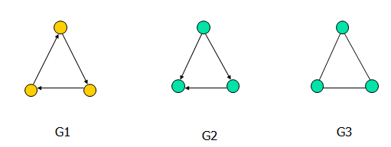
Connectivity- Directed Graph(CO5)
Directed Graph
Representation example: G1 (Strong component), G2 (Weak Component), G3 is undirected graph representation of G2 or G1
ANAMIKA TIWARI Discrete Structures Unit 5

Slide 69
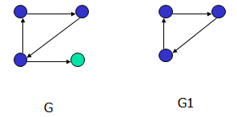
Connectivity- Directed Graph(CO5)
Directed Graph
Strongly connected Components: subgraphs of a Graph G that are strongly connected
Representation example: G1 is the strongly connected component in G
ANAMIKA TIWARI Discrete Structures Unit 5

Slide 70
Topic objective : Euler Graph(CO5)
Eulerian graphs will be used to solve many practical problems like Konisberg Bridge problem.
They can also be used to by mail carriers who want to have a route where they don’t retrace any of their previous steps.
ANAMIKA TIWARI Discrete Structures Unit 5

Slide 71
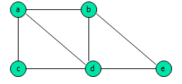
Euler- Definitions(CO5)
An Eulerian path (Eulerian trail, Euler walk) in a graph is a path that uses each edge precisely once. If such a path exists, the graph is called traversable.
An Eulerian cycle (Eulerian circuit, Euler tour) in a graph is a cycle that uses each edge precisely once. If such a cycle exists, the graph is called Eulerian (also unicursal).
Representation example: G1 has Euler path a, c, d, e, b, d, a, b
ANAMIKA TIWARI Discrete Structures Unit 5

Slide 72
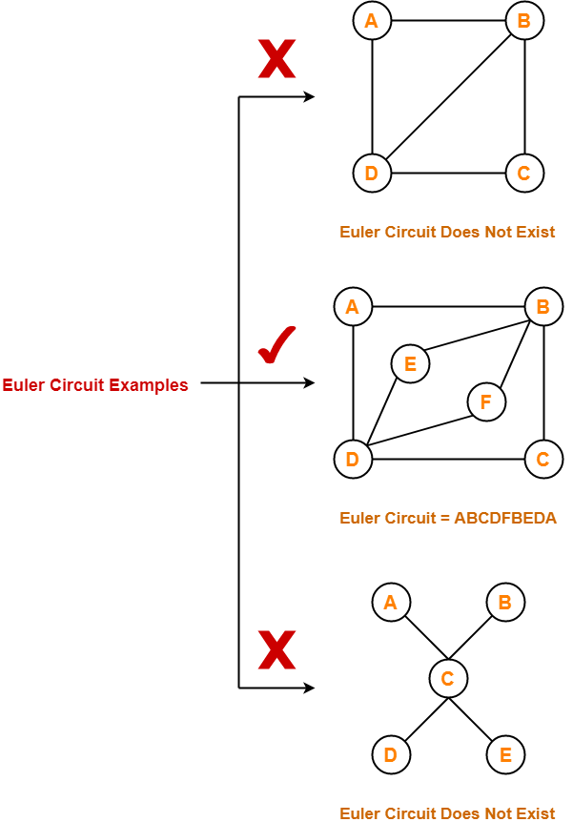
Euler Circuit(CO5)
ANAMIKA TIWARI Discrete Structures Unit 5

Slide 73
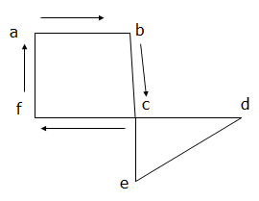
Euler Theorem1(CO5)
A connected graph G is Eulerian if and only if G is connected and has no vertices of odd degree.
Building a simple path:
{a,b}, {b,c}, {c,f}, {f,a}
Euler circuit constructed if all edges
are used. True here?
ANAMIKA TIWARI Discrete Structures Unit 5

Slide 74
Euler Theorem2 (CO5)
A connected graph G is has an Euler trail from node a to some other node b if and only if G is connected and a ≠ b are the only two nodes of odd degree.
Assume G has an Euler trail T from node a to node b (a and b not necessarily distinct).
For every node besides a and b, T uses an edge to exit for each edge it uses to enter. Thus, the degree of the node is even.
1. If a = b, then a also has even degree. → Euler circuit
2. If a ≠ b, then a and b both have odd degree. → Euler path
ANAMIKA TIWARI Discrete Structures Unit 5

Slide 75
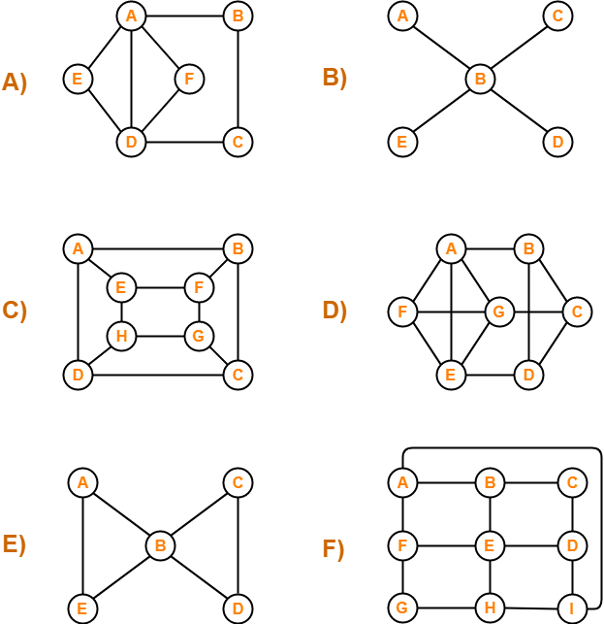
Eulerian Graphs(CO5)
A and E are Eulerian Graphs.
ANAMIKA TIWARI Discrete Structures Unit 5

Slide 76
Topic objective: Hamiltonian Graph(CO5)
It will be used in various fields such as Computer Graphics, electronic circuit design, mapping genomes, and operations research.
To plan bus route to pick up students (node->student, road-> edges, bus path-> Hamiltonian path)
To combine many tiny fragments of genetic code in genome mapping.
ANAMIKA TIWARI Discrete Structures Unit 5

Slide 77
Hamiltonian Graph(CO5)
Hamiltonian path (also called traceable path) is a path that visits each vertex exactly once.
A Hamiltonian cycle (also called Hamiltonian circuit, vertex tour or graph cycle) is a cycle that visits each vertex exactly once (except for the starting vertex, which is visited once at the start and once again at the end).
A graph that contains a Hamiltonian path is called a traceable graph. A graph that contains a Hamiltonian cycle is called a Hamiltonian graph. Any Hamiltonian cycle can be converted to a Hamiltonian path by removing one of its edges, but a Hamiltonian path can be extended to Hamiltonian cycle only if its endpoints are adjacent.
ANAMIKA TIWARI Discrete Structures Unit 5

Slide 78
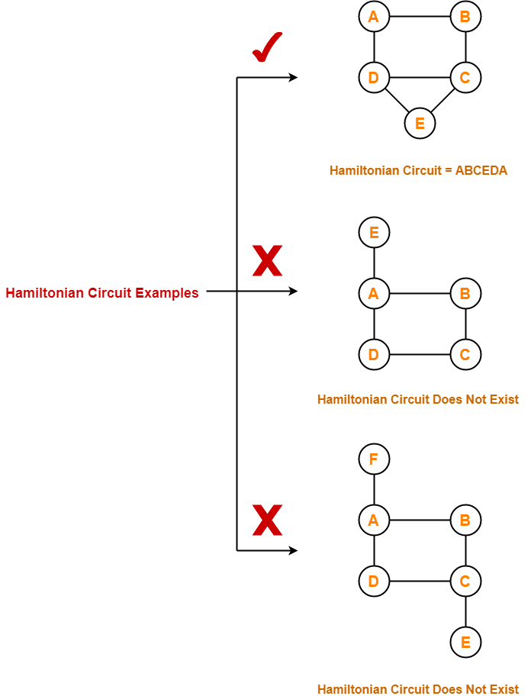
Hamiltonian Circuit(CO5)
ANAMIKA TIWARI Discrete Structures Unit 5

Slide 79
C, D and F are a Hamiltonian Graphs.
Hamiltonian Graph(CO5)
ANAMIKA TIWARI Discrete Structures Unit 5

Slide 80
Hamiltonian Graph Theorems(CO5)
DIRAC’S Theorem: if G is a simple graph with n vertices with n ≥ 3 such that the degree of every vertex in G is at least n/2 then G has a Hamilton circuit.
ORE’S Theorem: if G is a simple graph with n vertices with n ≥ 3 such that deg (u) + deg (v) ≥ n for every pair of nonadjacent vertices u and v in G, then G has a Hamilton circuit.
ANAMIKA TIWARI Discrete Structures Unit 5

Slide 81
Topic objective: Planar Graphs(CO4)
To design or to provide a solution for a graph structure in which crossing edges are a nuisance, including design problems for circuits, subways, utility lines.
ANAMIKA TIWARI Discrete Structures Unit 5

Slide 82
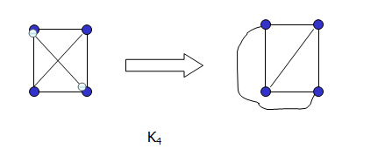
Planar Graphs(CO5)
A graph (or multigraph) G is called planar if G can be drawn in the plane with its edges intersecting only at vertices of G, such a drawing of G is called an embedding of G in the plane.
Application Example: VLSI design (overlapping edges requires extra layers), Circuit design (cannot overlap wires on board)
Representation examples: K1,K2,K3,K4 are planar, Kn for n>4 are non-planar
ANAMIKA TIWARI Discrete Structures Unit 5

Slide 83
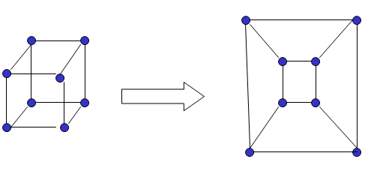
Planar Graphs(CO5)
Representation example
ANAMIKA TIWARI Discrete Structures Unit 5

Slide 84
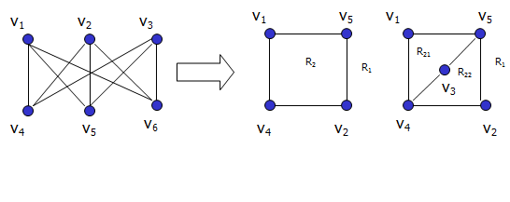
Planar Graphs(CO5)
Representation examples: K_{3,3} is Non-planar
ANAMIKA TIWARI Discrete Structures Unit 5

Slide 85
Planar Graph Theorem(CO5)
Theorem : Euler's planar graph theorem
For a connected planar graph or multigraph:
v – e + r = 2
number
of vertices
number
of regions
number
of edges
ANAMIKA TIWARI Discrete Structures Unit 5

Slide 86
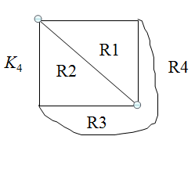
Planar Graph Theorem(CO5)
Example of Euler’s theorem
A planar graph divides the plane
into several regions (faces), one
of them is the infinite region.
v=4,e=6,r=4, v-e+r=2
ANAMIKA TIWARI Discrete Structures Unit 5

Slide 87

Planar Graphs(CO5)
Proof of Euler’s formula: By Induction
Base Case: for G1 , e₁ = 1, v₁ = 2 and r₁= 1
n+1 Case: Assume, r_{n} = e_{n} – v_{n} + 2 is true. Let {an+1, bn+1} be the edge that is added to Gn to obtain Gn+1 and we prove that r_{n} = e_{n} – v_{n} + 2 is true. Can be proved using two cases.
ANAMIKA TIWARI Discrete Structures Unit 5

Slide 88
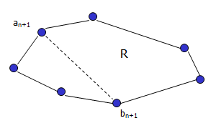
Planar Graphs(CO5)
Case 1:
r_{n+1} = r_{n} + 1, e_{n+1} = e_{n} + 1, v_{n+1} = v_{n} => r_{n+1} = e_{n+1} – v_{n+1} + 2
ANAMIKA TIWARI Discrete Structures Unit 5

Slide 89
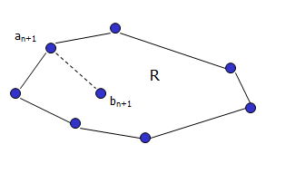
Planar Graphs(CO5)
Case 2:
r_{n+1} = r_{n}, e_{n+1} = e_{n} + 1, v_{n+1} = v_{n} + 1 => r_{n+1} = e_{n+1} – v_{n+1} + 2
ANAMIKA TIWARI Discrete Structures Unit 5

Slide 90
Planar Graph Corollary1(CO5)
Corollary 1: Let G = (V, E) be a connected simple planar graph with |V| = v, |E| = e > 2, and r regions. Then 3r ≤ 2e and e ≤ 3v – 6
Proof: Since G is loop-free and is not a multigraph, the boundary of each region (including the infinite region) contains at least three edges. Hence, each region has degree ≥ 3.
Degree of region: No. of edges on its boundary; 1 edge may occur twice on boundary -> contributes 2 to the region degree.
Each edge occurs exactly twice: either in the same region or in 2 different regions
ANAMIKA TIWARI Discrete Structures Unit 5

Slide 91
Planar Graphs(CO5)
Each edge occurs exactly twice: either in the same region or in 2 different regions
2e = sum of degree of r regions determined by 2e
2e ≥ 3r. (since each region has a degree of at least 3)
r ≤ (2/3) e
From Euler’s theorem, 2 = v – e + r
2 ≤ v – e + 2e/3
2 ≤ v – e/3
So 6 ≤ 3v – e
or e ≤ 3v – 6
ANAMIKA TIWARI Discrete Structures Unit 5

Slide 92
Planar Graph Corollary2 (CO5)
Corollary 2: Let G = (V, E) be a connected simple planar graph then G has a vertex degree that does not exceed 5
Proof: If G has one or two vertices the result is true
If G has 3 or more vertices then
by Corollary 1, e ≤ 3v – 6
2e ≤ 6v – 12
If the degree of every vertex were at least 6:by Handshaking theorem: 2e = Sum (deg(v))
2e ≥ 6v.
But this contradicts the inequality 2e ≤ 6v – 12
There must be at least one vertex with degree no greater than 5
ANAMIKA TIWARI Discrete Structures Unit 5

Slide 93
Planar Graph Corollary 3(CO5)
Corollary 3: Let G = (V, E) be a connected simple planar graph with v vertices ( v ≥ 3) , e edges, and no circuits of length 3 then e ≤ 2v -4
Proof: Similar to Corollary 1 except the fact that no circuits of length 3 imply that degree of region must be at least 4.
ANAMIKA TIWARI Discrete Structures Unit 5

Slide 94
Topic objective: Graph coloring(CO5)
It will be used for making Schedule or Time Table.
Register Allocation: assigning a large number of target program variables onto a small number of CPU registers
Mobile Radio Frequency Assignment: every tower represents a vertex and an edge between two towers represents that they are in range of each other.
Sudoku: There is an edge between two vertices if they are in same row or same column or same block.
It will check if a graph is Bipartite or not by coloring the graph using two colors
ANAMIKA TIWARI Discrete Structures Unit 5

Slide 95
Graph coloring(CO5)
Graph coloring is an assignment of "colors", almost always taken to be consecutive integers starting from 1 without loss of generality, to certain objects in a graph. Such objects can be vertices, edges, faces, or a mixture of the above.
Vertex coloring is the most common graph coloring problem. The problem is, given m colors, find a way of coloring the vertices of a graph such that no two adjacent vertices are colored using same color.
Application examples: scheduling, register allocation in a microprocessor, frequency assignment in mobile radios, and pattern matching.
ANAMIKA TIWARI Discrete Structures Unit 5

Slide 96
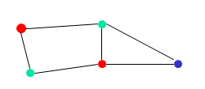
Vertex Coloring Problem(CO5)
Assignment of colors to the vertices of the graph such that proper coloring takes place (no two adjacent vertices are assigned the same color)
Chromatic number: least number of colors needed to color the graph
A graph that can be assigned a (proper) k-coloring is k-colorable, and it is k-chromatic if its chromatic number is exactly k.
3-chromatic
ANAMIKA TIWARI Discrete Structures Unit 5

Slide 97
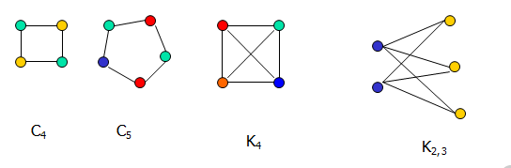
Vertex Coloring Problem(CO5)
The problem of finding a minimum coloring of a graph is NP-Hard
The corresponding decision problem (Is there a coloring which uses at most k colors?) is NP-complete
The chromatic number for C_{n} = 3 (n is odd) or 2 (n is even), K_{n} = n, K_{m,n} = 2
Cn: cycle with n vertices; Kn: fully connected graph with n vertices; Km,n: complete bipartite graph
ANAMIKA TIWARI Discrete Structures Unit 5

Slide 98
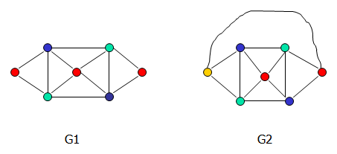
The Four color theorem(CO5)
the Four color theorem, or the four color map theorem, states that, given any separation of a plane into contiguous regions, producing a figure called a map, no more than four colors are required to color the regions of the map so that no two adjacent regions have the same color
The Four color theorem: the chromatic number of a planar graph is no greater than 4
Example: G1 chromatic number = 3, G2 chromatic number = 4
(Most proofs rely on case by case analysis).
ANAMIKA TIWARI Discrete Structures Unit 5

Slide 99
Breadth first search (BFS) (CO5)
BFS Algorithm
The concept is to visit all the neighbor vertices before visiting other neighbor vertices of neighbor vertices.
Steps:
Initialize status of all nodes as “Ready”.
Put source vertex in a queue and change its status to “Waiting”.
Repeat the following two steps until queue is empty −
Remove the first vertex from the queue and mark it as “Visited”.
Add to the rear of queue all neighbors of the removed vertex whose status is “Ready”. Mark their status as “Waiting”.
ANAMIKA TIWARI Discrete Structures Unit 5

Slide 100
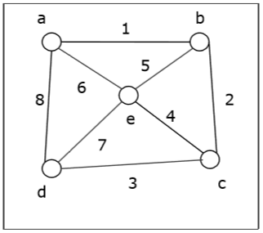
Breadth first search (BFS) (CO5)
Let us take a graph (Source vertex is ‘a’) and apply the BFS algorithm to find out the traversal order.
Initialize status of all vertices to “Ready”.
Put a in queue and change its status to “Waiting”.
Remove a from queue, mark it as “Visited”.
Add a’s neighbors in “Ready” state b, d and e to end of queue and mark them as “Waiting”.
ANAMIKA TIWARI Discrete Structures Unit 5

Slide 101
Breadth first search (BFS) (CO5)
Remove b from queue, mark it as “Visited”, put its “Ready” neighbor c at end of queue and mark c as “Waiting”.
Remove d from queue and mark it as “Visited”. It has no neighbor in “Ready” state.
Remove e from queue and mark it as “Visited”. It has no neighbor in “Ready” state.
Remove c from queue and mark it as “Visited”. It has no neighbor in “Ready” state.
Queue is empty so stop.
So the traversal order is a→b→d→e→c
Complexity analysis of BFS is O(|V|+|E|).O(|E|)
ANAMIKA TIWARI Discrete Structures Unit 5

Slide 102
Application of BFS (CO5)
Finding the shortest path
Minimum spanning tree for un-weighted graph
GPS navigation system
Detecting cycles in an undirected graph
Finding all nodes within one connected component
ANAMIKA TIWARI Discrete Structures Unit 5

Slide 103
Depth first search (DFS) (CO5)
DFS Algorithm
The concept is to visit all the neighbor vertices of a neighbor vertex before visiting the other neighbor vertices.
Initialize status of all nodes as “Ready”
Put source vertex in a stack and change its status to “Waiting”
Repeat the following two steps until stack is empty −
Pop the top vertex from the stack and mark it as “Visited”
Push onto the top of the stack all neighbors of the removed vertex whose status is “Ready”. Mark their status as “Waiting”.
ANAMIKA TIWARI Discrete Structures Unit 5

Slide 104
Depth first search (DFS) (CO5)
Let us take a graph (Source vertex is ‘a’) and apply the DFS algorithm to find out the traversal order.
ANAMIKA TIWARI Discrete Structures Unit 5

Slide 105
Depth first search (DFS) (CO5)
Initialize status of all vertices to “Ready”.
Push a in stack and change its status to “Waiting”.
Pop a and mark it as “Visited”.
Push a’s neighbors in “Ready” state e, d and b to top of stack and mark them as “Waiting”.
Pop b from stack, mark it as “Visited”, push its “Ready” neighbor c onto stack.
Pop c from stack and mark it as “Visited”. It has no “Ready” neighbor.
Pop d from stack and mark it as “Visited”. It has no “Ready” neighbor.
Pop e from stack and mark it as “Visited”. It has no “Ready” neighbor.
Stack is empty. So stop.
So the traversal order is a→b→c→d
Complexity Analysis of DFS is ⊝(|V|+|E|)
ANAMIKA TIWARI Discrete Structures Unit 5

Slide 106
Application of DFS (CO5)
Detecting cycle in a graph
To find topological sorting
To test if a graph is bipartite
Finding connected components
Finding the bridges of a graph
Finding bi-connectivity in graphs
Solving the Knight’s Tour problem
Solving puzzles with only one solution
ANAMIKA TIWARI Discrete Structures Unit 5

Slide 107
Daily Quiz(CO 5)
For which of the following combinations of the degrees of vertices would the connected graph be eulerian?
a) 1,2,3 b) 2,3,4
c) 2,4,5 d) 1,3,5
A graph with all vertices having equal degree is known as a __________
a) Multi Graph b) Regular Graph
c) Simple Graph d) Complete Graph
Which of the following ways can be used to represent a graph?
a) Adjacency List and Adjacency Matrix
b) Incidence Matrix
c) Adjacency List, Adjacency Matrix as well as Incidence Matrix
d) No way to represent
Consider an undirected random graph of eight vertices. The probability that there is an edge between a pair of vertices is 1/2. What is the expected number of unordered cycles of length three?
a) 1/8 b)1
c) 7 d)8
ANAMIKA TIWARI Discrete Structures Unit 5

Slide 108
Daily Quiz(CO 5)
5. A graph is a collection of.... ?
a) Row and columns b) Vertices and edges
c) Equations d) None of these
6. The degree of any vertex of graph is .... ?
a) The number of edges incident with vertex
b) Number of vertex in a graph
c) Number of vertices adjacent to that vertex
d) Number of edges in a graph
7. A graph with no edges is known as empty graph. Empty graph is also known as... ?
a) Trivial graph
b) Regular graph
c) Bipartite graph
d) None of these
ANAMIKA TIWARI Discrete Structures Unit 5

Slide 109
Daily Quiz(CO 5)
8. If the origin and terminus of a walk are same, the walk is known as... ?
a) Open b) Closed
c) Path d) None of these
9. Radius of a graph, denoted by rad(G) is defined by.... ?
a) max {e(v): v belongs to V }
b) min { e(v): v belongs to V}
c) max { d(u,v): u belongs to v, u does not equal to v }
d) min { d(u,v): u belongs to v, u does not equal to v }
10. A graph G is called a ..... if it is a connected acyclic graph
a) Cyclic graph b) Regular graph
c) Tree d) Not a graph
11. A graph is a collection of
a) Row and columns b) Vertices and edges
c) Equations d) None of these
ANAMIKA TIWARI Discrete Structures Unit 5

Slide 110
Daily Quiz(CO 5)
12. How many relations are there on a set with n elements that are symmetric and a set with n elements that are reflexive and symmetric ?
a) 2n(n+1)/2 and 2n.3n(n–1)/2
b) 3n(n–1)/2 and 2n(n–1)
c) 2n(n+1)/2 and 3n(n–1)/2
d) 2n(n+1)/2 and 2n(n–1)/2
13. In a graph if e=(u, v) means
a) u is adjacent to v but v is not adjacent to u
b)e begins at u and ends at v
c) u is processor and v is successor
d) both b and c
14. A minimal spanning tree of a graph G is
a) A spanning sub graph
b) A tree
c) Minimum weights
d) All of above
ANAMIKA TIWARI Discrete Structures Unit 5

Slide 111
Weekly Assignment(CO 5)
Q1.Explain different type of graph with example.
Q2.Explain different terminology of graph with example
Q3. Define incidence and adjacency matrix of graph with example.
Q4.Explain graph and digraph with example.
Q5. Explain planar graph with example.
Q6.Explain Euler circuit and Euler path.
Q7. what is isomorphic graph.
Q8.Explain chromatic number .
Q9. For the expression (7-(4*5))+(9/3) which of the following is the post order tree traversal?
Q10. Define planar graph. Prove that for any connected planar graph, v – e+ r = 2 Where v, e, r is the number of vertices, edges, and regions of the graph respectively.
ANAMIKA TIWARI Discrete Structures Unit 5

Slide 112
Faculty Video Links, Youtube & NPTEL Video Links and Online Courses Details (CO 5)
Youtube/other Video Links:
https://www.youtube.com/watch?v=Dsi7x-A89Mw&list=PL0862D1A94725 2D20&index=28
https://www.youtube.com/watch?v=74l6t4_4pDg&list=PL0862D1A947252D20&index=29
https://www.youtube.com/watch?v=4d2XEn1j_q4&list=PL0862D1A947252D20&index=30
https://www.youtube.com/watch?v=qvw1GX93JSY&list=PL0862D1A947252D20&index=32
https://www.youtube.com/watch?v=ImLM1Vsr35c&list=PL0862D1A947252D20&index=33
ANAMIKA TIWARI Discrete Structures Unit 5

Slide 113
MCQs(CO 5)
Q1. Which of the following statements for a simple graph is correct?
a) Every path is a trail
b) Every trail is a path
c) Every trail is a path as well as every path is a trail
d) Path and trail have no relation
Q2. What is the number of edges present in a complete graph
having n vertices?
a) (n*(n+1))/2
b) (n*(n-1))/2
c) n
d) Information given is insufficient
Q3. In a simple graph, the number of edges is equal to twice
the sum of the degrees of the vertices.
a) True
b) False
ANAMIKA TIWARI Discrete Structures Unit 5

Slide 114
MCQs(CO 5)
Q4. A connected planar graph having 6 vertices, 7 edges contains_____________ regions.
a) 15 b) 3
c) 1 d) 11
Q5. If a simple graph G, contains n vertices and m edges, the number of edges in the Graph G'(Complement of G) is ___________
a) (n*n-n-2*m)/2 b)(n*n+n+2*m)/2
c) (n*n-n-2*m)/2 d) (n*n n+2*m)/2
Q6. Which of the following properties does a simple graph not hold?
a) Must be connected b) Must be unweighted
c) Must have no loops or multiple edges d) Must have no multiple edges
Q7. What is the maximum number of edges in a bipartite graph having 10 vertices?
a) 24 b) 21
c) 25 d) 16
ANAMIKA TIWARI Discrete Structures Unit 5

Slide 115
MCQs(CO 5)
Q8 An undirected graph G which is connected and acyclic is called ____________
a) bipartite graph
b) cyclic graph
c) tree
d) forest
Q9. An n-vertex graph has ______ edges.
a) n²
b) n-1
c) n*n
d) n*(n+1)/2
Q10. The tree elements are called __________
a) vertices
b) nodes
c) points
d) edges
ANAMIKA TIWARI Discrete Structures Unit 5

Slide 116
MCQs(CO 5)
Q11. What is a bipartite graph?
a) a graph which contains only one cycle
b) a graph which consists of more than 3 number of vertices
c) a graph which has odd number of vertices and even number of edges
d) a graph which contains no cycles of odd length
Q12. How many cycles are there in a wheel graph of order 5?
a) 6
b) 10
c) 25
d) 7
Q13. The time complexity to find a Eulerian path in a graph of vertex V and edge E is _____________
a) O(V²)
b) O(V+E-1)
c) O(V+E)
d) O(E+1)
ANAMIKA TIWARI Discrete Structures Unit 5

Slide 117
MCQs(CO 5)
Q14. In preorder traversal of a binary tree the second step is ____________
a) traverse the right subtree
b) traverse the left subtree
c) traverse right subtree and visit the root
d) visit the root
Q15. What is the minimum height for a binary search tree with 60 nodes?
a) 1
b) 3
c) 4
d) 2
Q16. For the expression (7-(4*5))+(9/3) which of the following is the post order tree traversal?
a) *745-93/+
b) 93/+745*-
c) 745*-93/+
d) 74*+593/-
ANAMIKA TIWARI Discrete Structures Unit 5

Slide 118
GLOSSARY QUESTION (CO5)
n-vertex graph has edges 1. directed acyclic graph
undirected graph G which is connected and acyclic 2. tree
polytree is called 3. n-1
The tree elements are called 4. nodes
an n-ary tree, each vertex has at most children 5. n
graph which consists of disjoint union of trees is called 6. 360
7-node directed cyclic graph, the number of Hamiltonian cycle 7. forest
G has degree at most 23 then G can have a vertex colouring of 8. bipartite graph
the vertex set and the edge set are finite sets 9. 24
A Tree is a connected 10. acyclic undirected graph
ANAMIKA TIWARI Discrete Structures Unit 5

Slide 119
Old Question Papers(CO 5)
Q1 Construct a binary tree from the given two Travels (IGDTUW, 2020)
In order 1, 2, 3, 4, 5, 6, 7, 8, 9, 10, 11
Post order 1, 4, 3, 2, 6, 8, 9, 11, 10, 7, 5
Q2 Define Hamiltonian graph with suitable example. (Anna Univ, 2017)
Q3 Define planar graph. Prove that for any connected planar graph, v – e+ r = 2 Where v, e, r is the number of vertices, edges, and regions of the graph respectively. (AKTU, 2017)
Q4. What are different ways to represent a graph. Define Euler circuit and Euler graph. Give necessary and sufficient conditions for Euler circuits and paths. (KTU,2017)
Q5. For the expression (7-(4*5))+(9/3) which of the following is the post order tree traversal?
Q6. What are application of a Depth First Search traversal ? (Anna Univ, 2017)
Q7. What is the Worst case complexity of Breadth First Search traversal ? (NIET Autonomous, 2021)
Q8. What are the applications of Breadth First Search traversal? (KTU, 2017)
For more Previous year Question papers:
https://drive.google.com/drive/folders/1xmt08wjuxu71WAmO9Gxj2iDQ0lQf-so1
ANAMIKA TIWARI Discrete Structures Unit 5

Slide 120
Expected Questions for Exam(CO 5)
Q1. Define Hamiltonian graph with suitable example
Q2. Define planar graph. Prove that for any connected planar graph, v – e+ r = 2 Where v, e, r is the number of vertices, edges, and regions of the graph respectively.
Q3. What are different ways to represent a graph. Define Euler circuit and Euler graph. Give necessary and sufficient conditions for Euler circuits and paths
Q4.Construct a binary tree from the given two Travels
In order 1, 2, 3, 4, 5, 6, 7, 8, 9, 10, 11
Post order 1, 4, 3, 2, 6, 8, 9, 11, 10, 7,
Q5. For the expression (7-(4*5))+(9/3) which of the following is the post order tree traversal?
Q6. What are application of a Depth First Search traversal ?
Q7. What is the Worst case complexity of Breadth First Search traversal ?
Q8. What are the applications of Breadth First Search traversal?
Q9. For the expression (7-(4*5))+(9/3) which of the following is the post order tree traversal?
ANAMIKA TIWARI Discrete Structures Unit 5

Slide 121
RECAP OF UNIT (CO5)
Tree Terminology
A tree is a hierarchical data structure defined as a collection of nodes. Nodes represent value and nodes are connected by edges. A tree has the following properties:
The tree has one node called root. The tree originates from this, and hence it does not have any parent.
Each node has one parent only but can have multiple children.
Each node is connected to its children via edge.
Binary Tree: In a Binary tree, every node can have at most 2 children, left and right. In diagram below, B & D are left children and C, E & F are right children.
Balanced Tree: If the height of the left and right subtree at any node differs at most by 1, then the tree is called a balanced tree.
GRAPH- In discrete mathematics, a graph is a collection of points, called vertices, and lines between those points, called edges.
ANAMIKA TIWARI Discrete Structures Unit 5

Slide 122
RECAP OF UNIT (CO5)
The concept of graphs in graph theory stands up on some basic terms such as point, line, vertex, edge, degree of vertices, properties of graphs, etc.
Graph theory has several application in real world.
Graph theory used in Computer networks to minimize the cost and time of delivery of data.
To distinguish between two chemical compounds with the same molecular formula but different structures.
To solve shortest path problems between cities.
To schedule exams and assign channels to television stations.
ANAMIKA TIWARI Discrete Structures Unit 5

Slide 123

ANAMIKA TIWARI Discrete Structures Unit 5

